Slide 1
Towards The Unsupervised Detection of Novel RFI Sources
Participants:
Sean Bohun (UOIT),
Nicholas Bruce (UVic),
Chris Budd (Bath),
Ryan Campbell (McGill),
Rory Coles (UOIT),
Dave DelRizzo (DRAO),
Stephen Harrison (DRAO),
Seth Siegel (McGill)

Slide 2
Introduction
The Dominion Radio Astrophysical Observatory (DRAO) is located in a geographically isolated region near Penticton B.C.
This is the site of a multitude of sensitive RF detectors that require a quiet RF spectrum to effectively operate.
For any given day, the site can experience any number of transient RF signals due to a variety of sources.

Slide 3
IPSW Questions
DRAO would like to develop the capability to:
Classify and Cluster the set of known RF sources as they are determined
Identify any novel RF sources that have not been previously classified
Provide a set of descriptors for each novel source
Update the clusters dynamically as novel sources are identified
Once identified, the hope is that any novel sources can be eliminated with this technique.

Slide 4
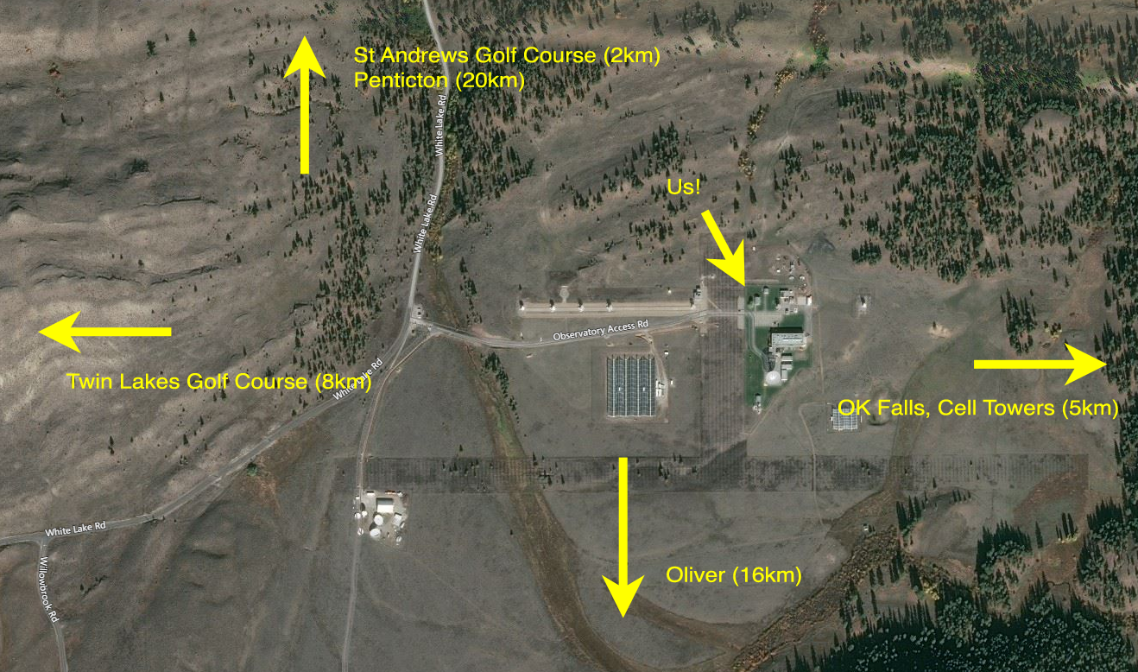
Site map

Slide 5
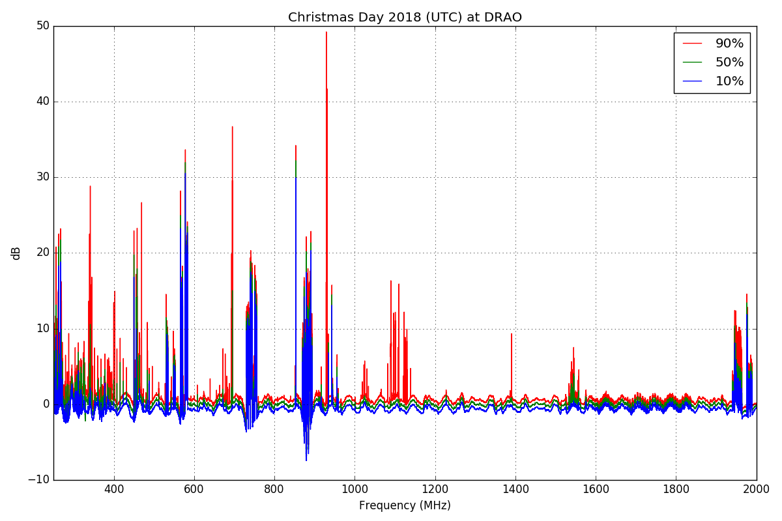
RFI: Static

Slide 6
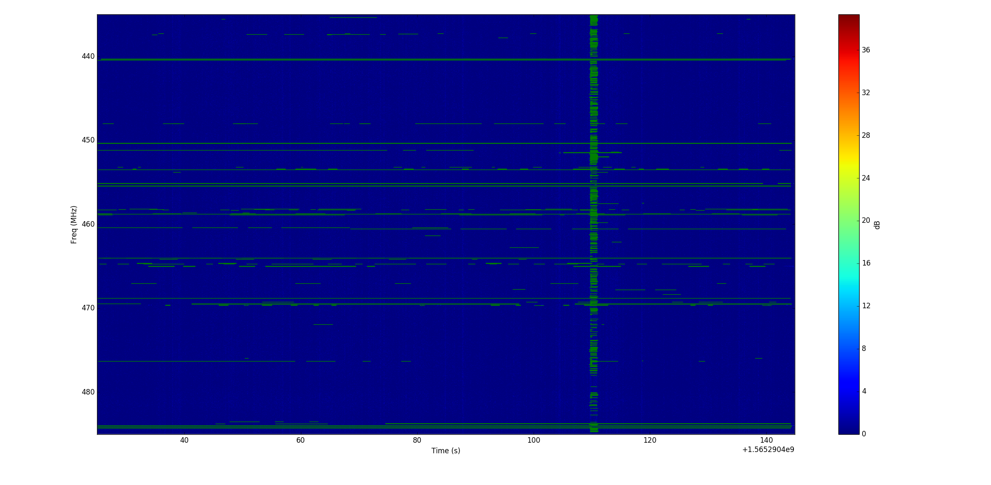
The Dynamic RF Scene
Detection of RFI in time-frequency space.
ML bounding box approach.
Notes:
50 MHz for 2 minutes. This is the data we brought, 30 files like this (1 hour of observing). We want to observe 2000 MHz for all day every day.
1kHz frequency resolution
100ms time resolution. We would like to observe higher cadence.
Bounding box approach tries to draw a box around the frequency and time range in which one signal exists.
Point out vertical stripe: Some electrical equipment generates a short wideband burst of RF energy. This is a different class of events, but we are interested in characterizing them.

Slide 7
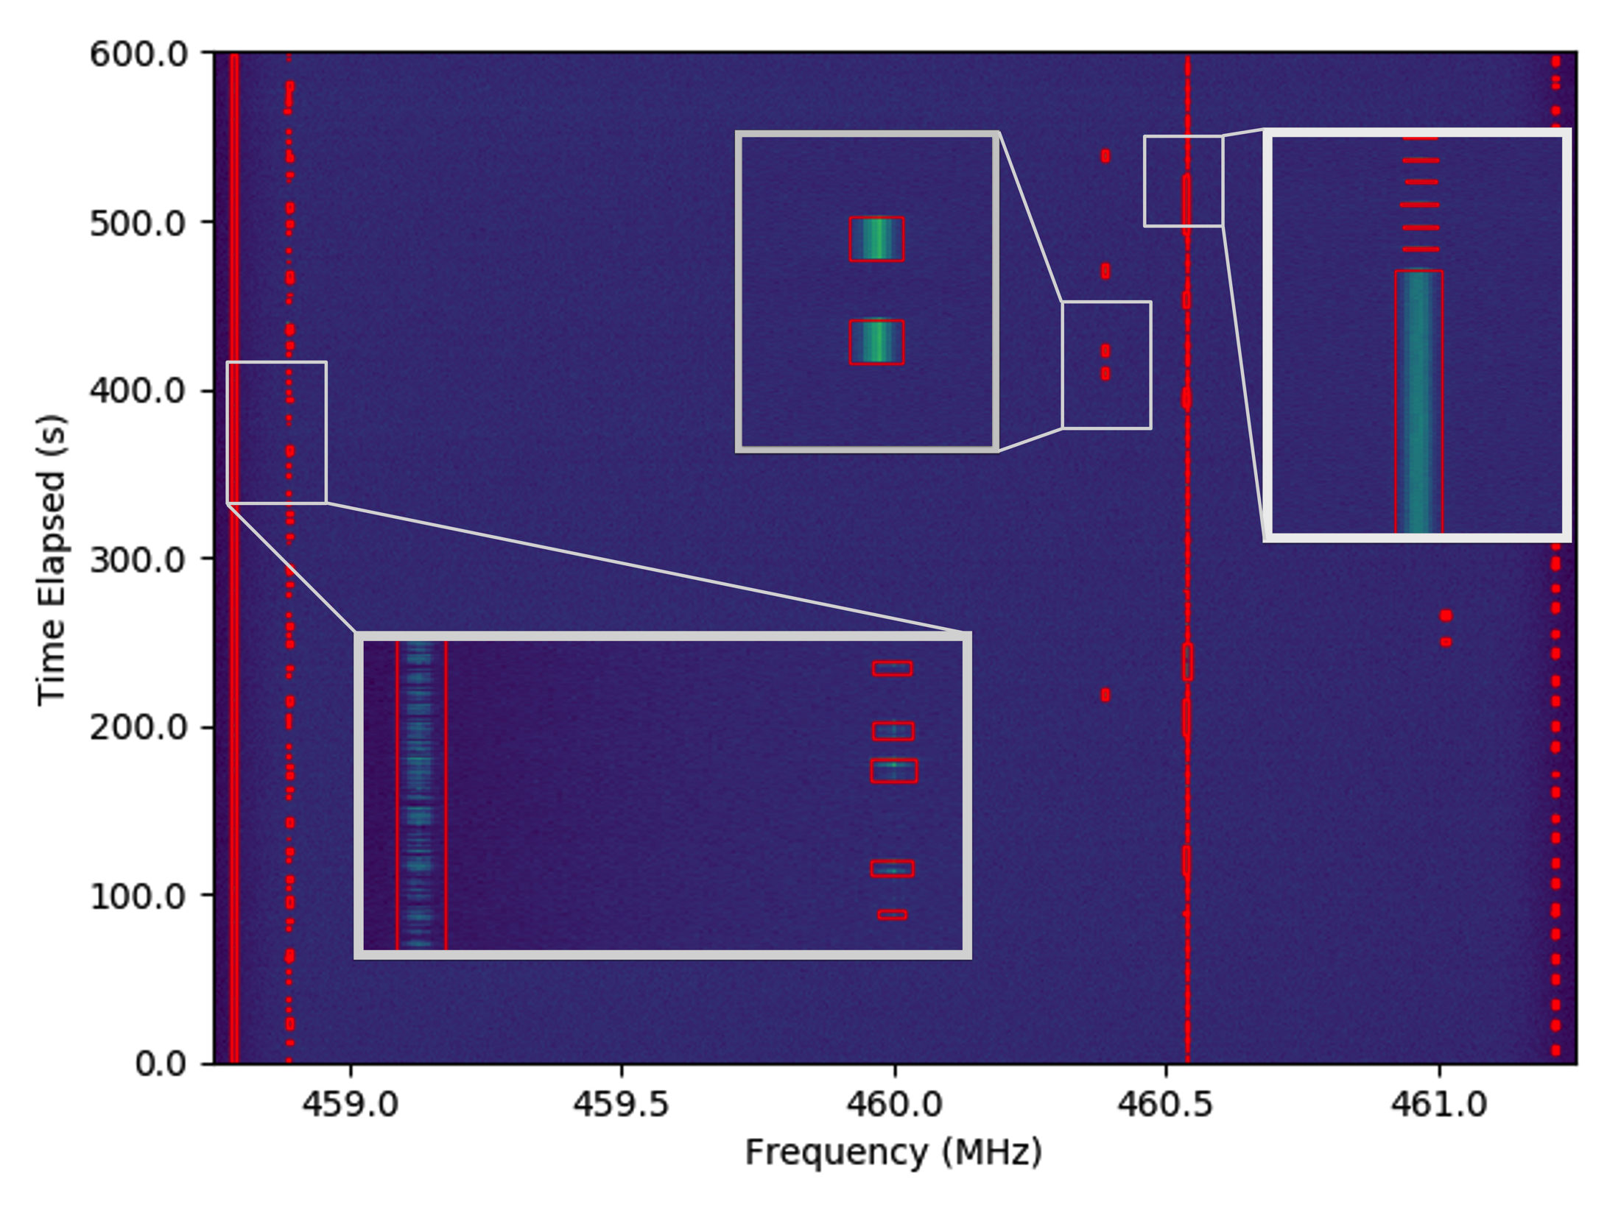
Separate the signals by using a bounding box

Slide 8
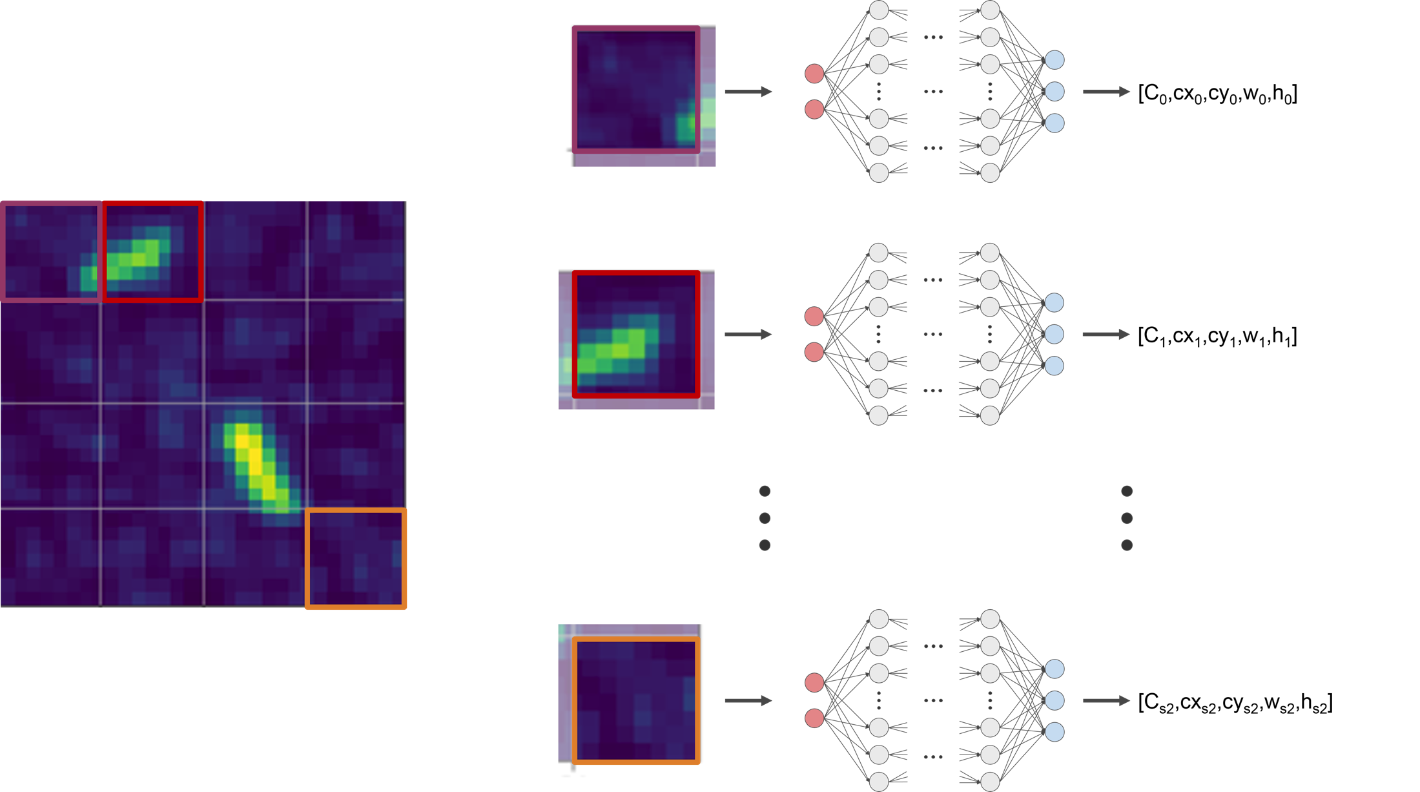

Slide 9
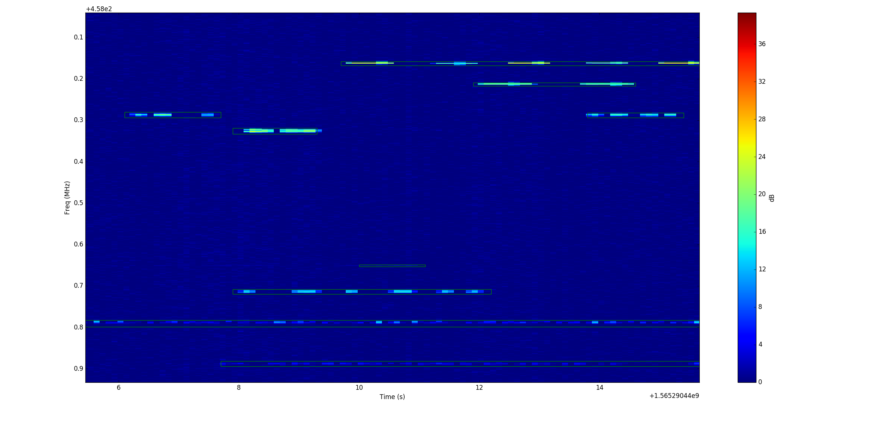
Results: Separated signals

Slide 10
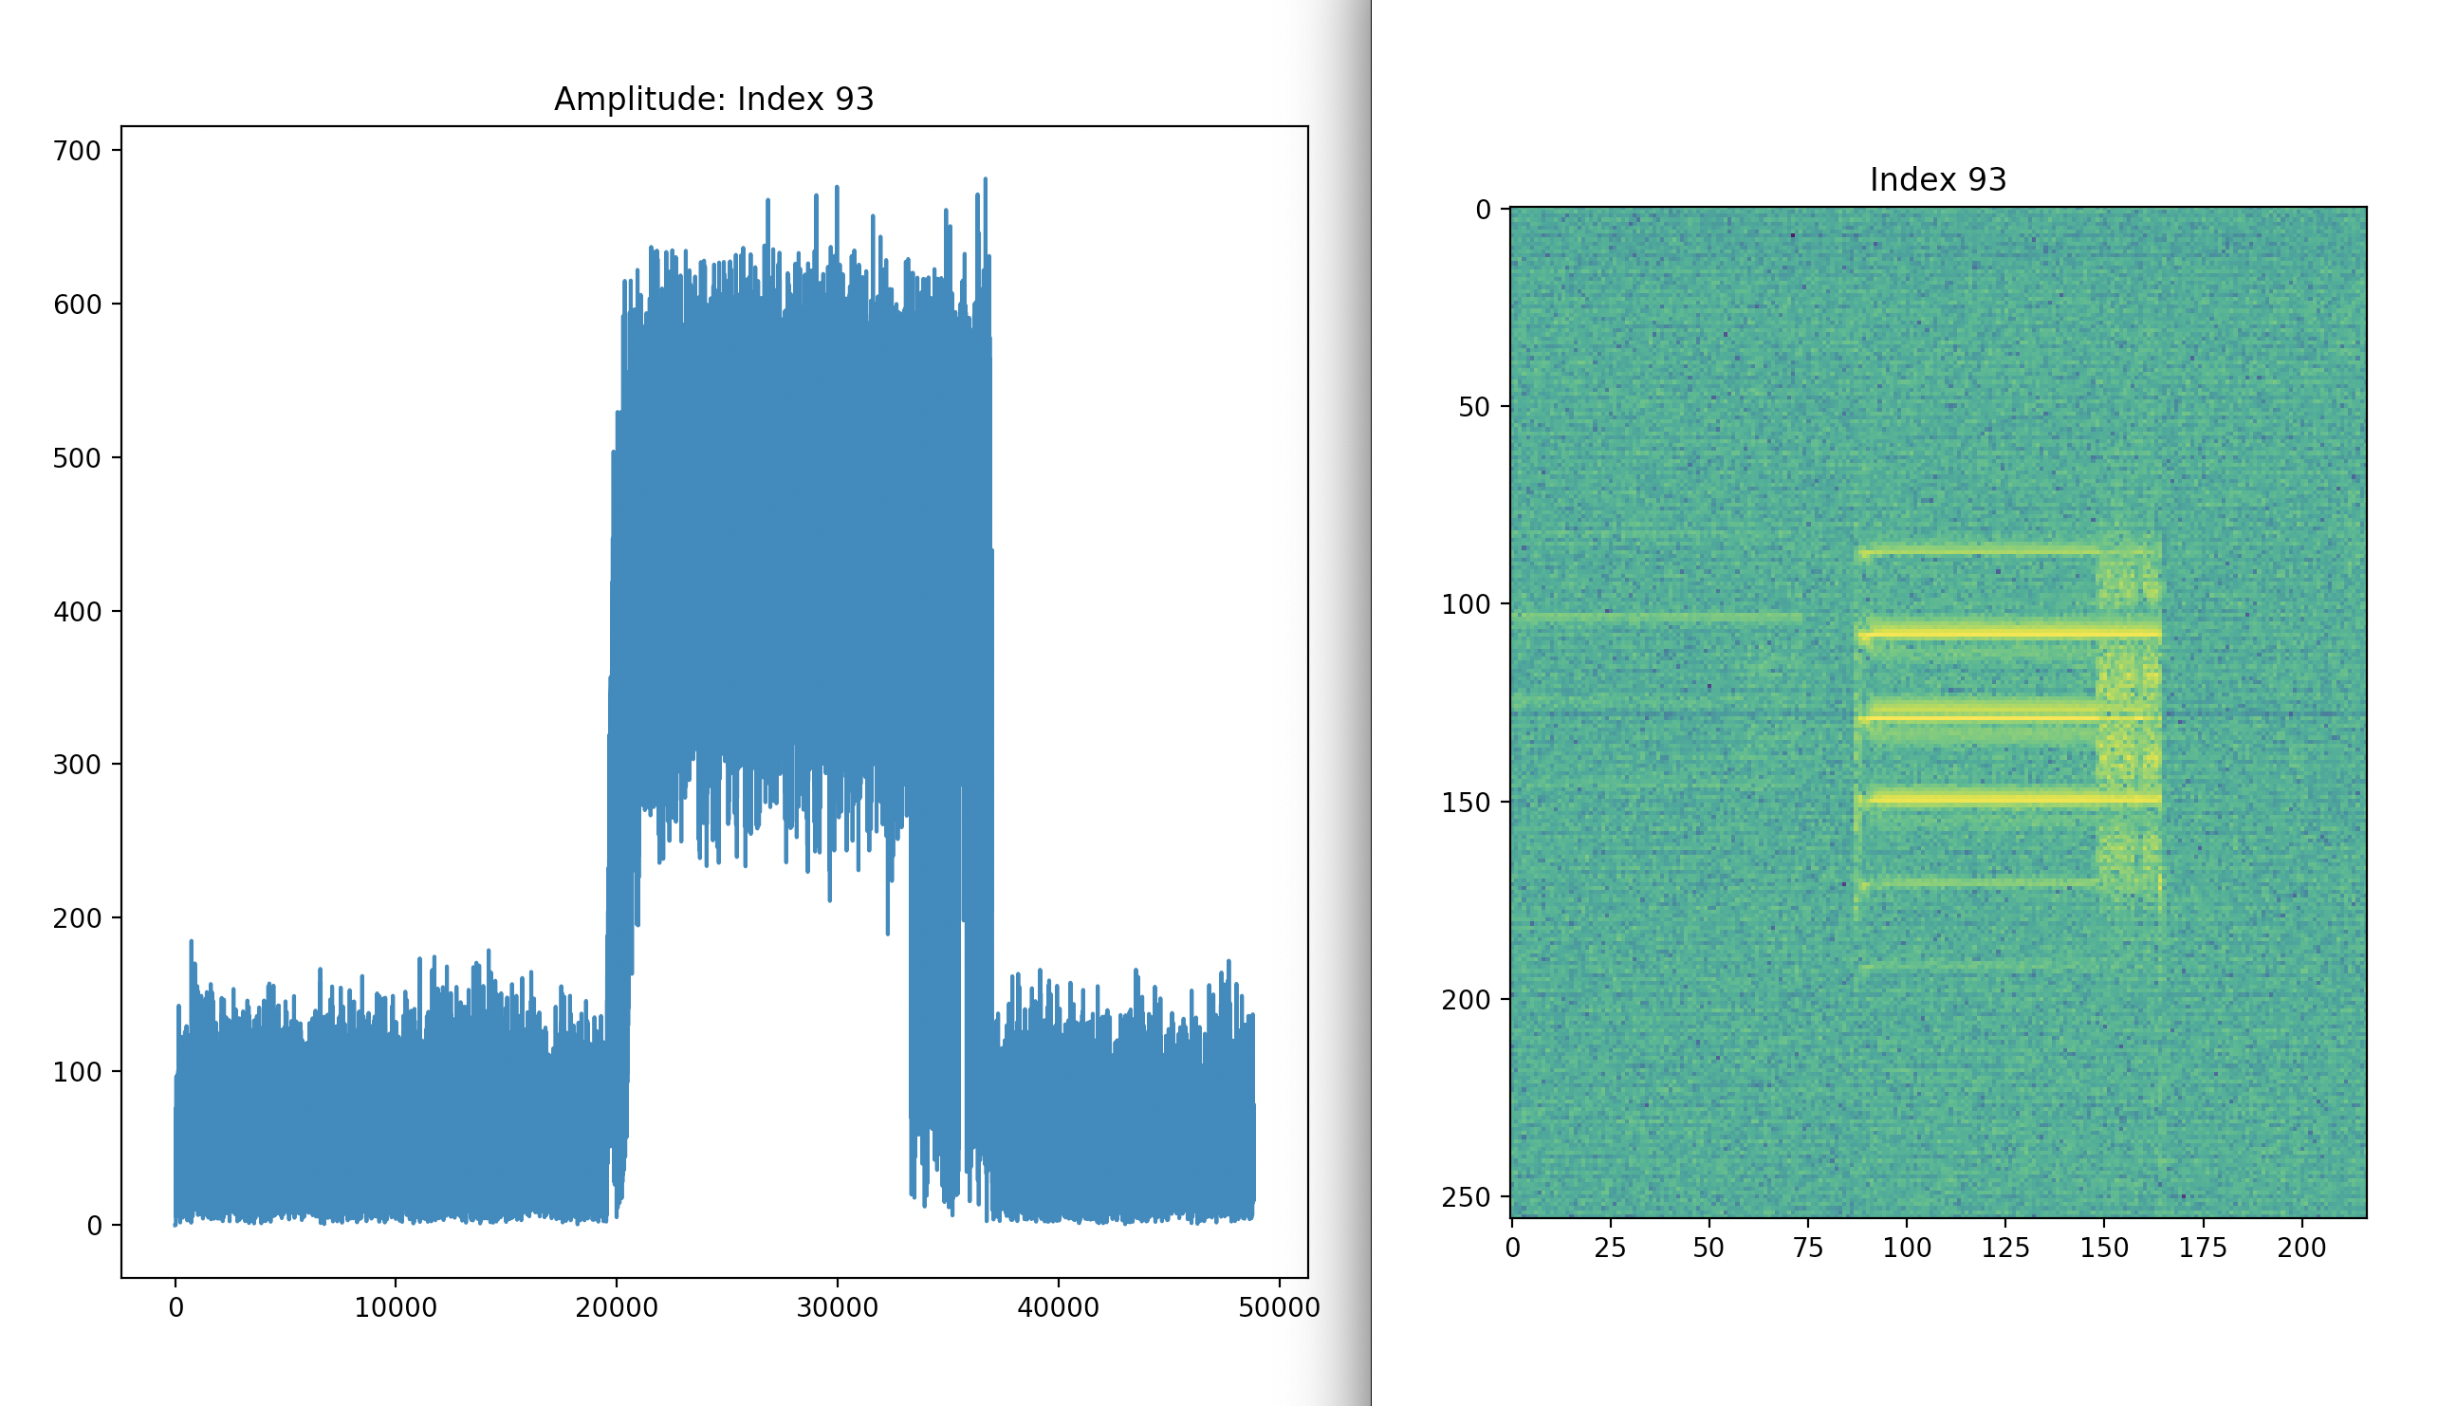
Sample signal types Short tone burst
Spectrograph
A
f
t
t

Slide 11
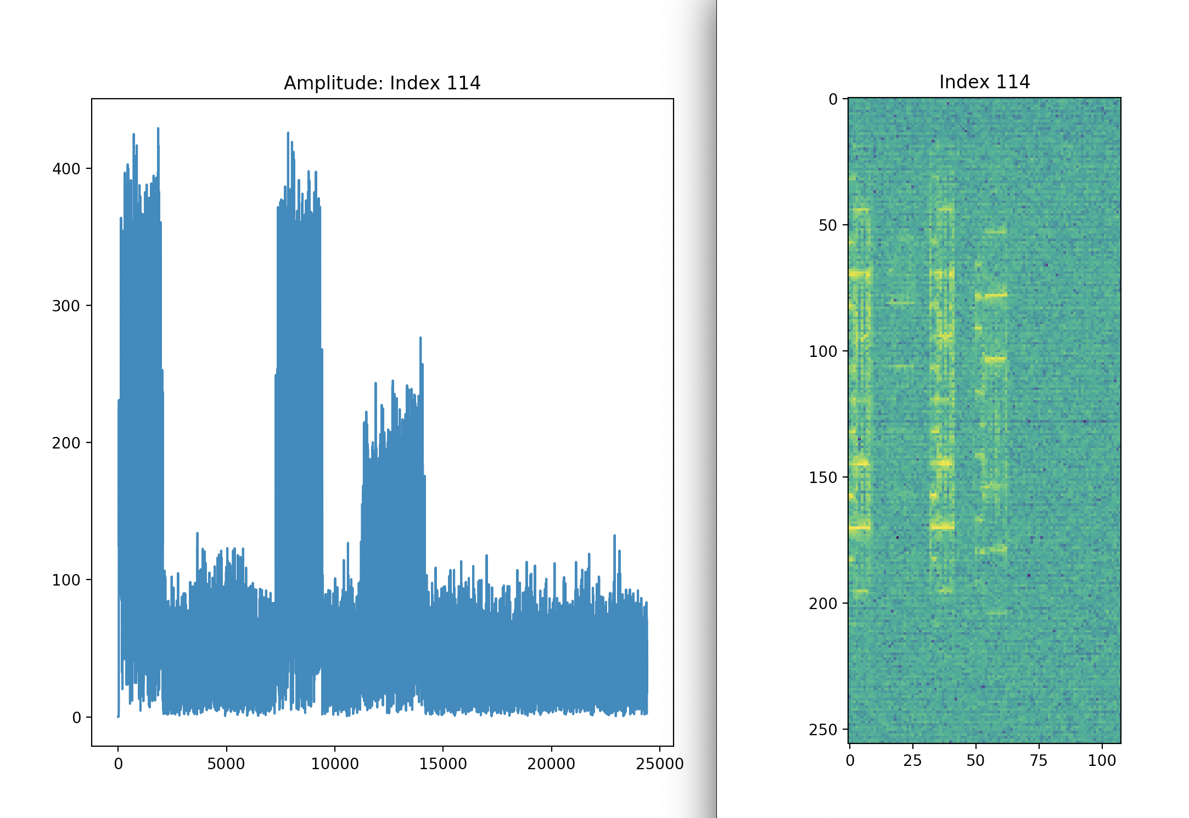
Frequency Shift Key (FSK)

Slide 12
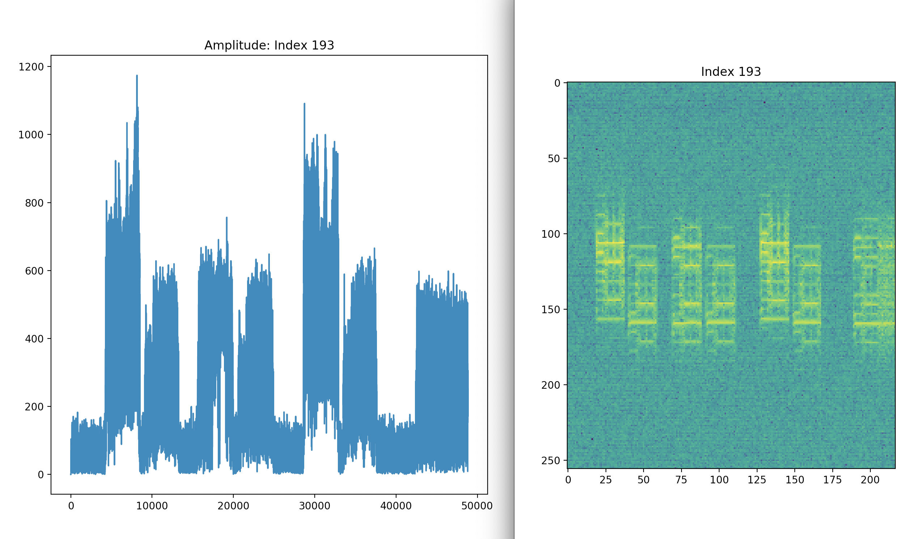
Amplitude Shift Key (ASK)

Slide 13
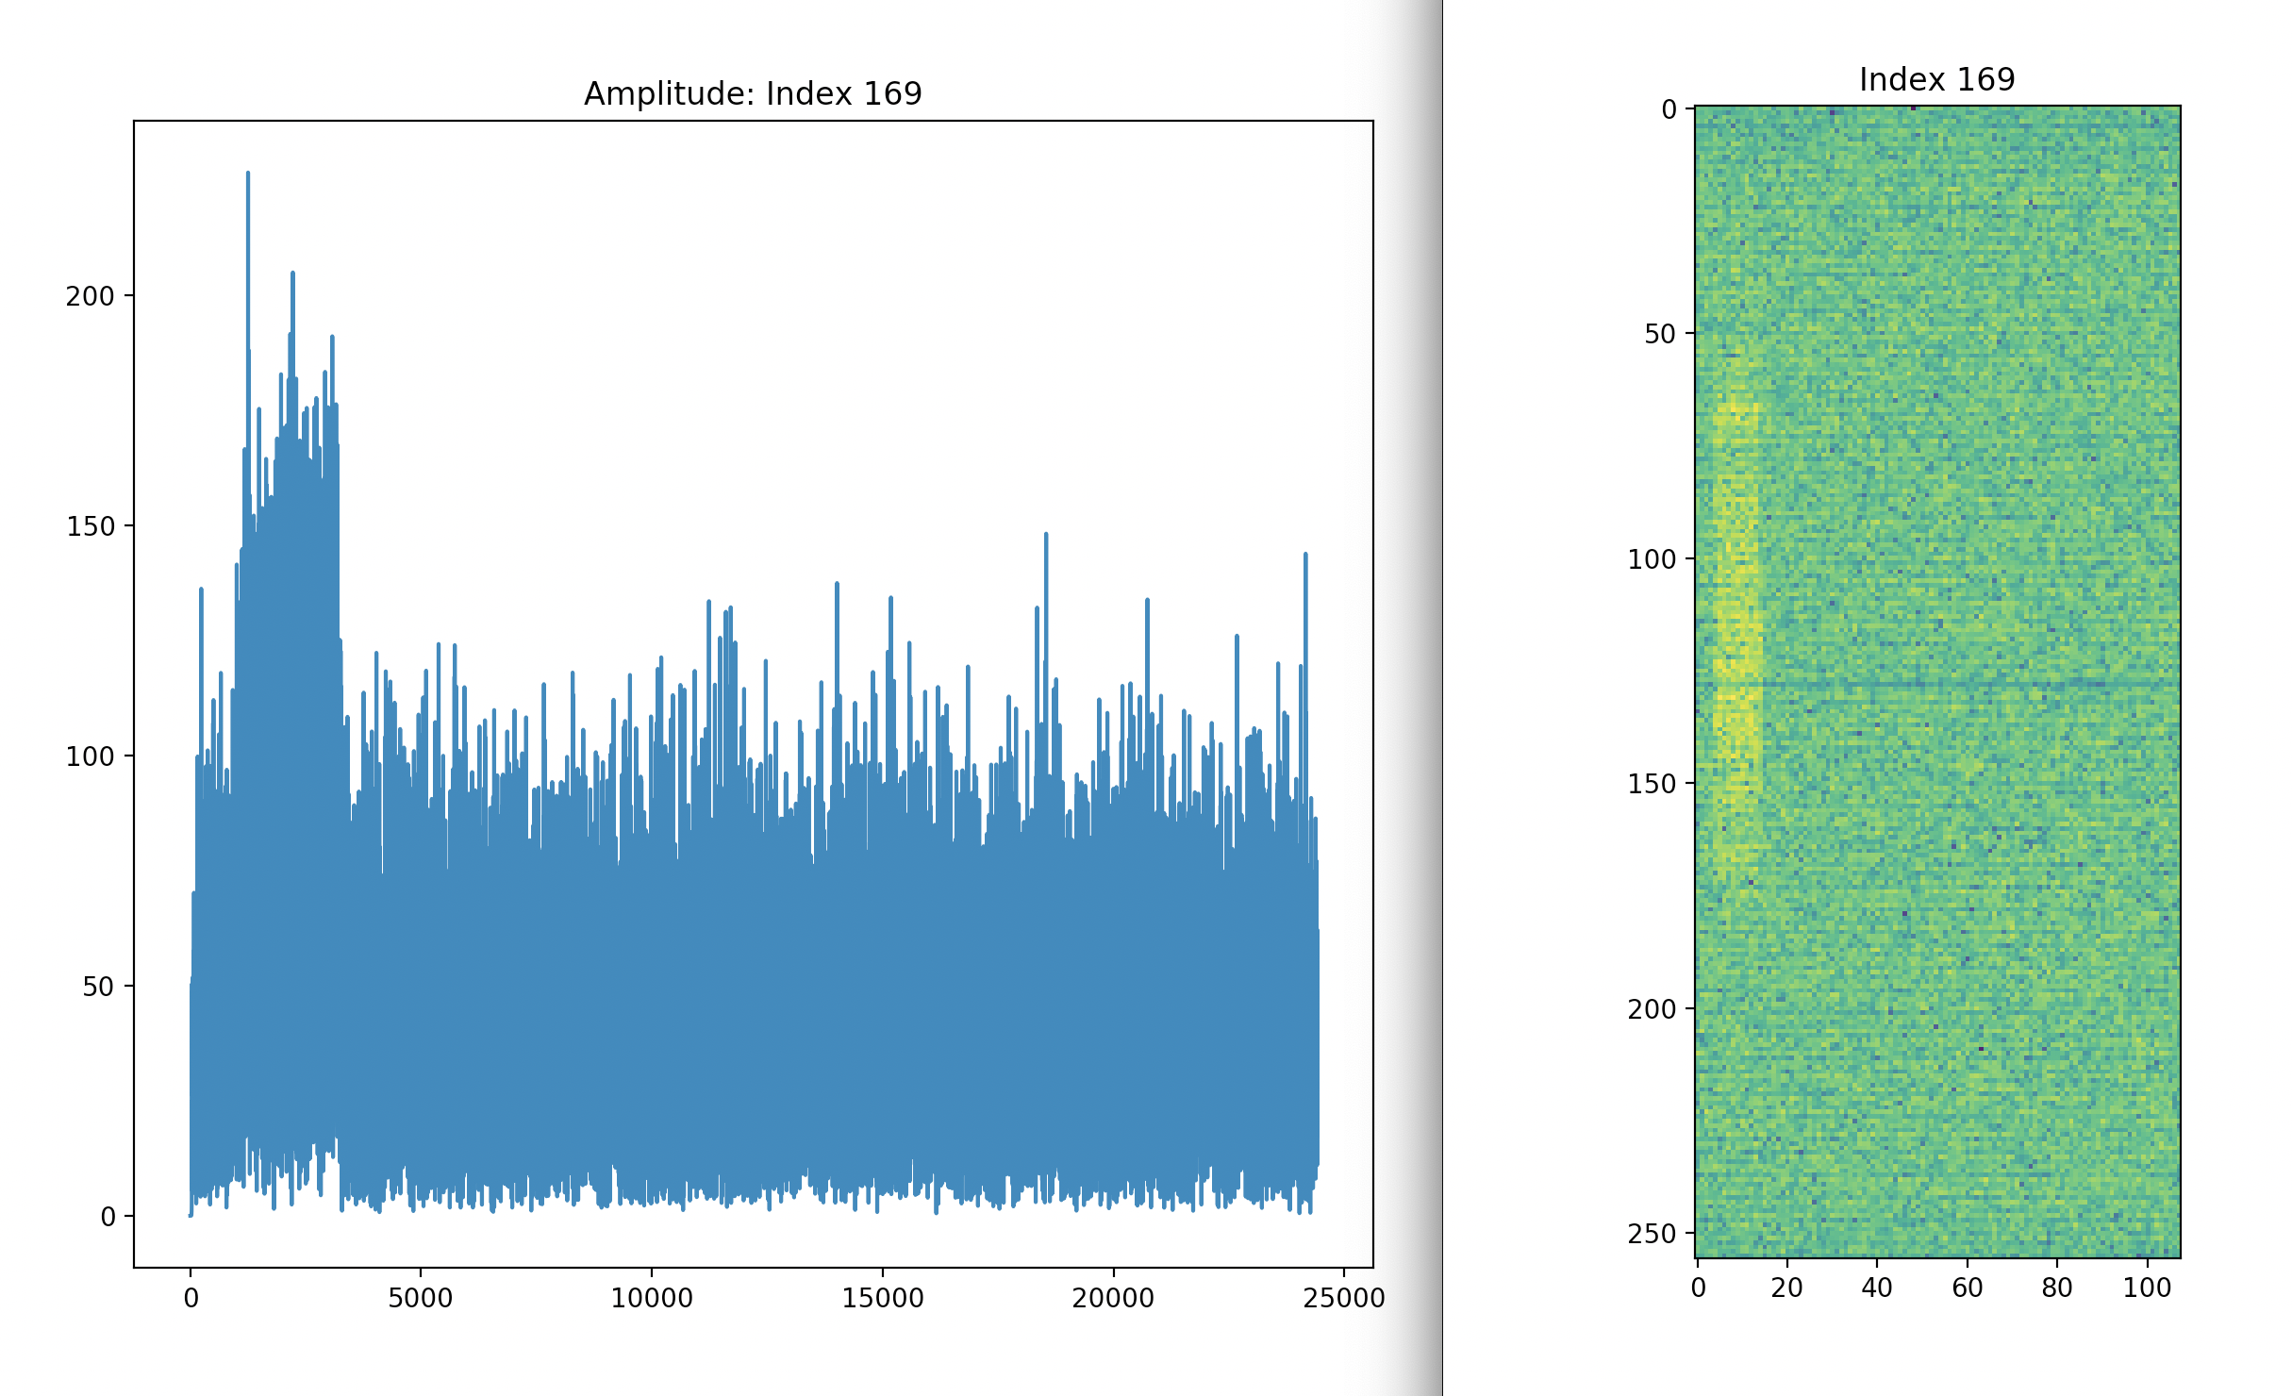
Noisy burst

Slide 14
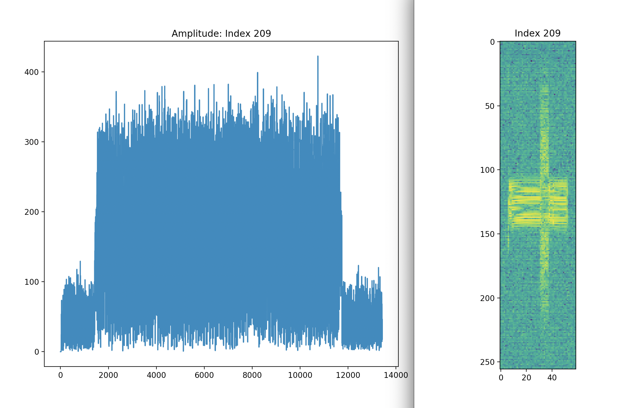
Unknown (Box)

Slide 15
Want to differentiate between different signals
Signals have different modulation types
eg:
Analogue: AM, SSB,DSB, FM, PM,
Digital: ASK, FSK, PSK, QAM, BPSK
Can separate signals by looking at their modulation types

Slide 16
Cumulants
Higher order cumulants are claimed to be able to do this
Higher order moment
Higher order cumulant

Slide 17
Papers claiming this base their claims on using polynomial supervised learning from synthetic data!
We are using unsupervised learning from real data

Slide 18
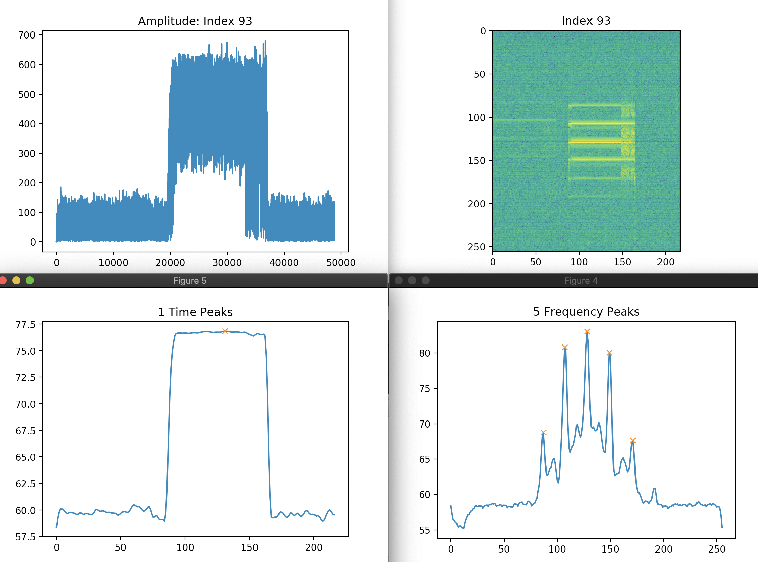
Also: Count the number of time and frequency peaks

Slide 19
Features vector
From each detection, the following 13 features were extracted for use in clustering:
Number of peaks in the frequency direction
Number of peaks in the time direction
Prominence of the major frequency peak
Avg. spacing of the frequency peaks
Avg. spacing of the time peaks
Normalized power centroid in the time direction
Width in the frequency direction (channels)
Center Frequency (Hz)
Bandwidth (Hz)
C₄₂ (4th order power cumulant)
C₆₃ (6th order power cumulant)
Transmission length (seconds)
P_{db} (2nd order power cumulant)

Slide 20
Clustering the feature vectors in the data
Various algorithms exist for clustering: DBSCAN, WARD (Matlab)
Cluster on the cumulants

Slide 21
Cluster on number of time and frequency peaks

Slide 22
Hierarchical clustering
The two cluster indices appear to be independent
Time-frequency cluster index: tf
Cumulant index: cc

Slide 23
Combine the cluster indices
Give a combined cluster index vector
I = (cc,tf)
This seems to be effective in classifying the signals and identifying new signals

Slide 24
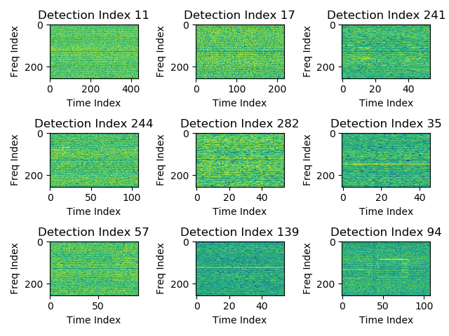
Cluster 1: I = (2,4)

Slide 25
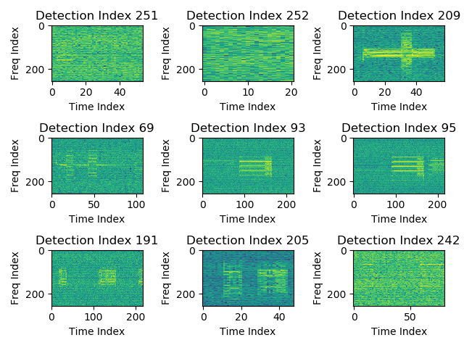
Cluster 2: I = (2,2)

Slide 26
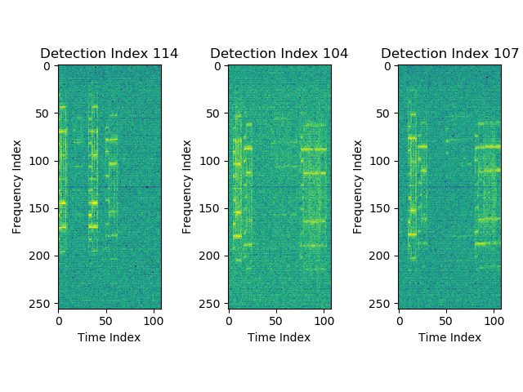
Cluster 3: I = (1,3)

Slide 27
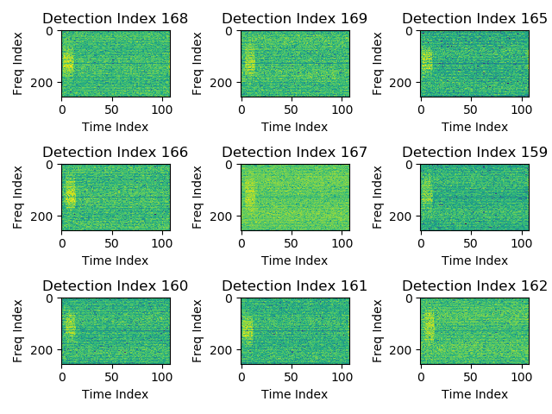
Cluster 7: I = (1,4)

Slide 28
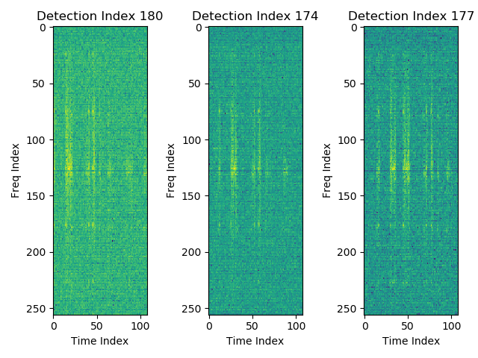
Cluster 8: I = (1,1)

Slide 29
Conclusions and future work

